Slide 1
The Front End Stack
As of 2019

Slide 2
A brief history of web tech
HTML, CSS, and JavaScript throughout the years

Slide 3
HTML (Hypertext Markup Language)
Plain ol’ HTML files
Preprocessors (PHP, Jinja2, Handlebars)
HTML-in-JS (JSX, Angular, Vue.js)

Slide 4
CSS (Cascading Style Sheets)
External CSS files
Preprocessors (Sass, Less, Stylus)
CSS-in-JS (styled-components, glamor, emotion)
CSS-in-HTML (Inline styles)

Slide 5
JavaScript (the old parts)
One global scope
Namespacing
IIFE (Immediately Invoked Function Expression)
CommonJS modules (Node.js)

Slide 6
JavaScript (the new parts)
ES6 Modules
Dynamic imports
Entering the almighty webpack

Slide 7
webpack
Throwing stuff together (aka module bundler)

Slide 8
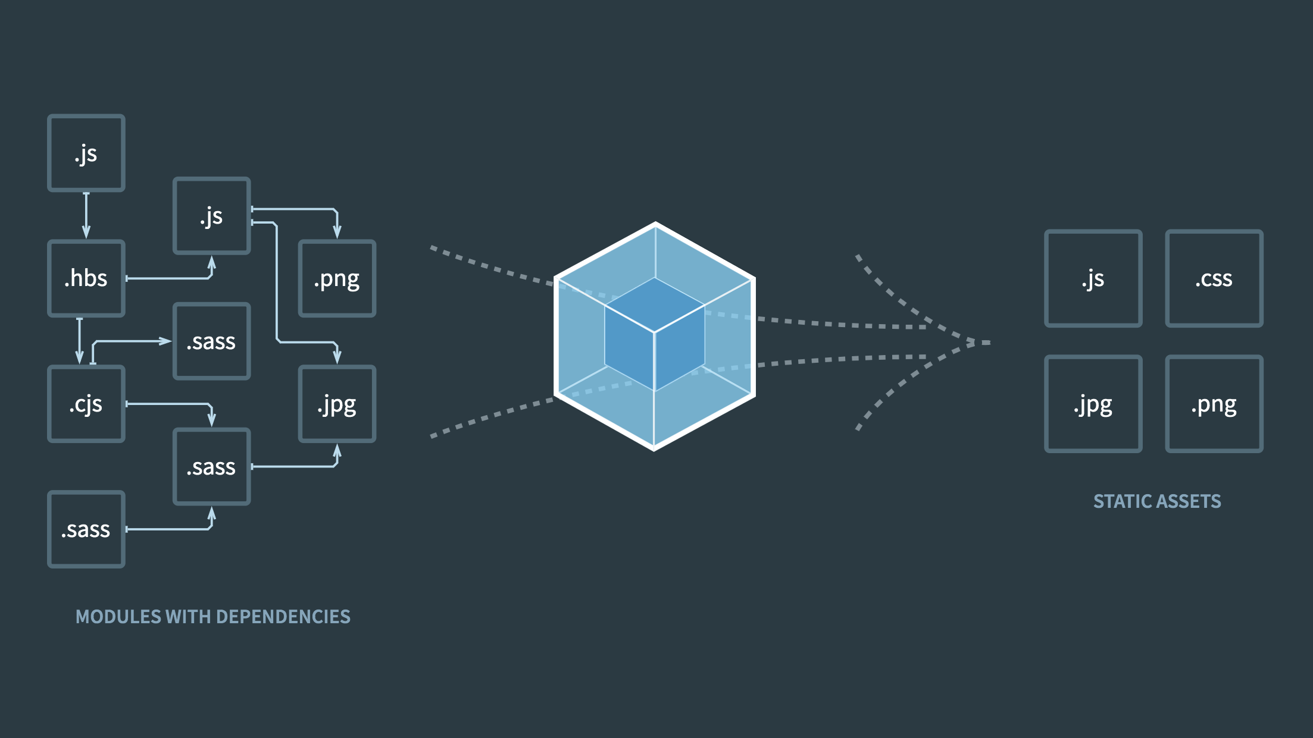

Slide 9

https://www.youtube.com/watch?v=jFc898NTh5Q

Slide 10
Babel
Transform something into usable JavaScript (aka compiler)

Slide 11
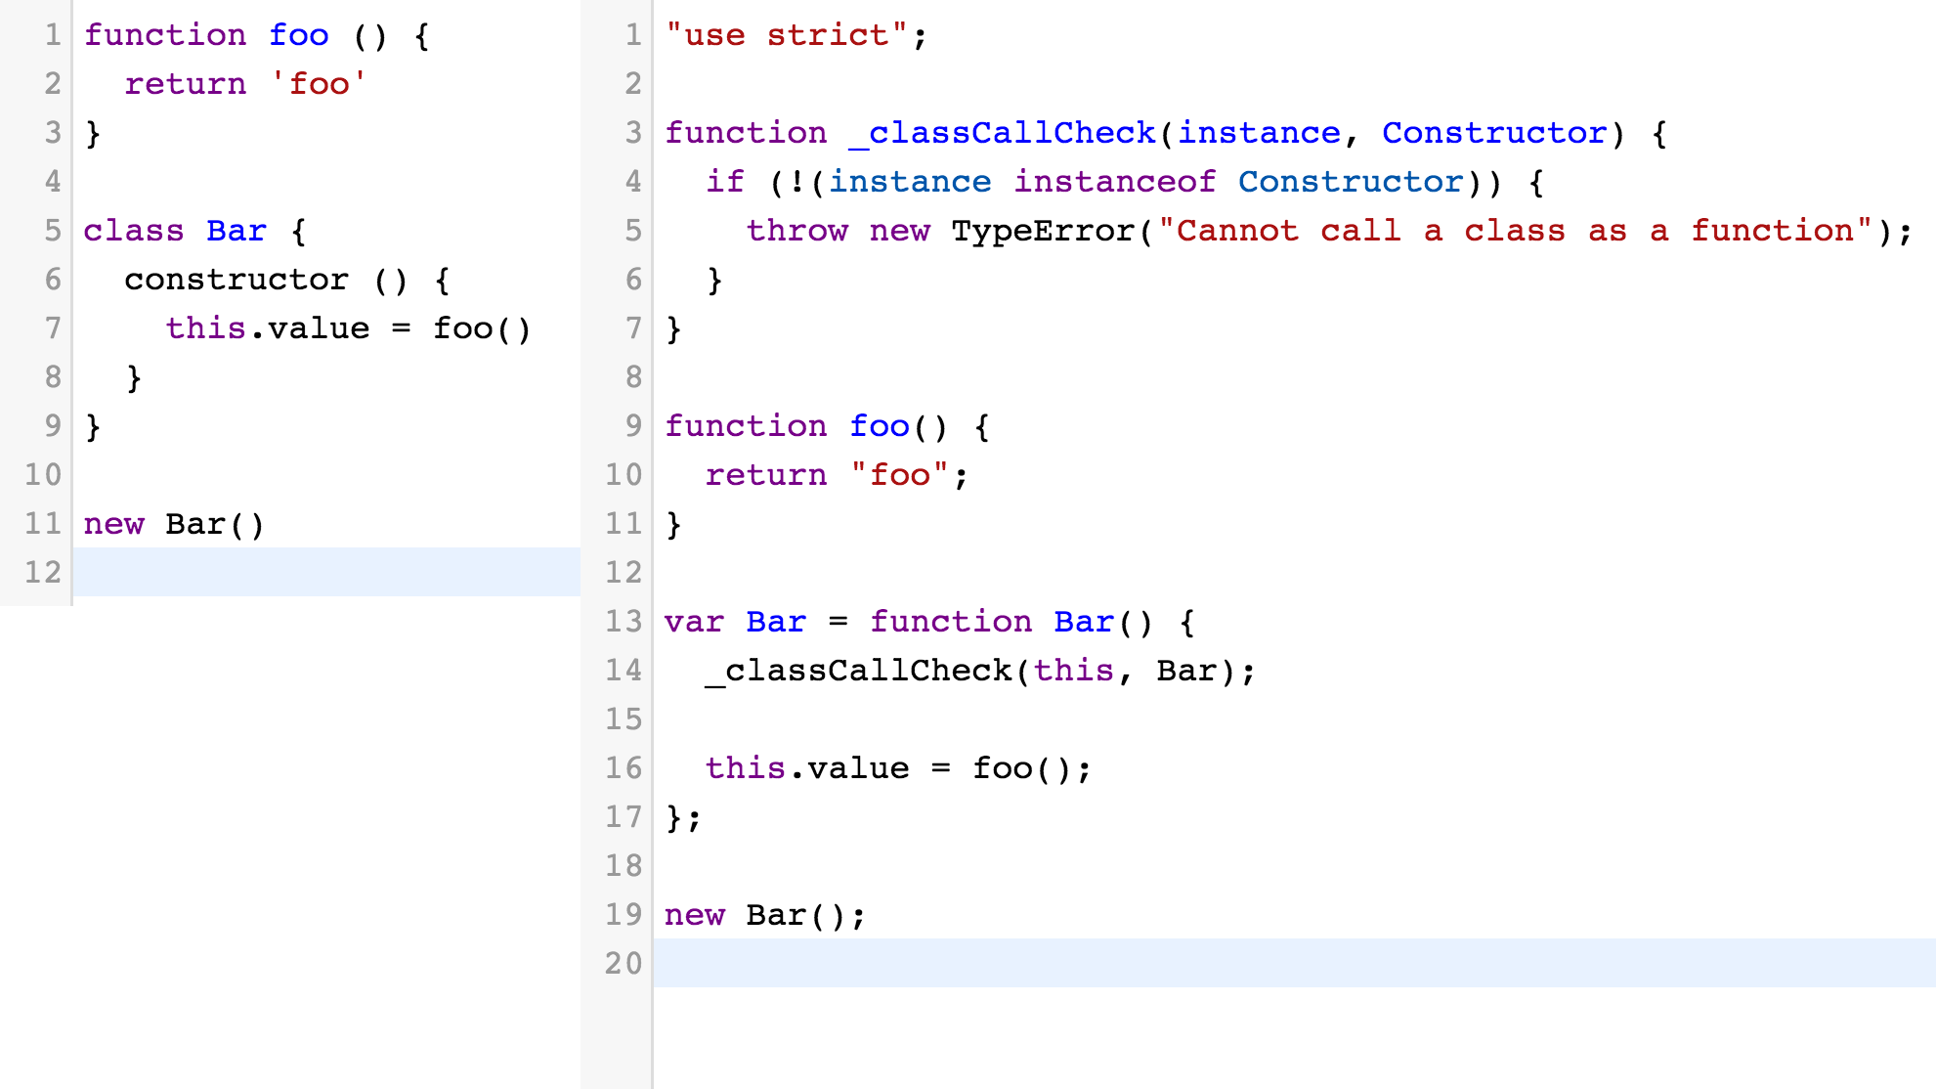

Slide 12
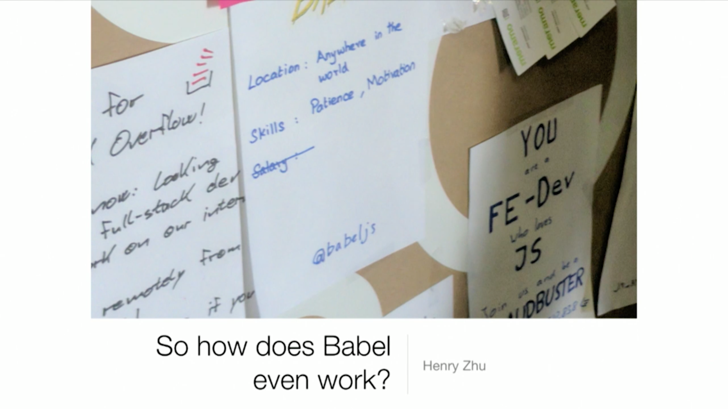
https://www.youtube.com/watch?v=fntd0sPMOtQ

Slide 13
Vue.js
Getting fancy with Single File Components

Slide 14
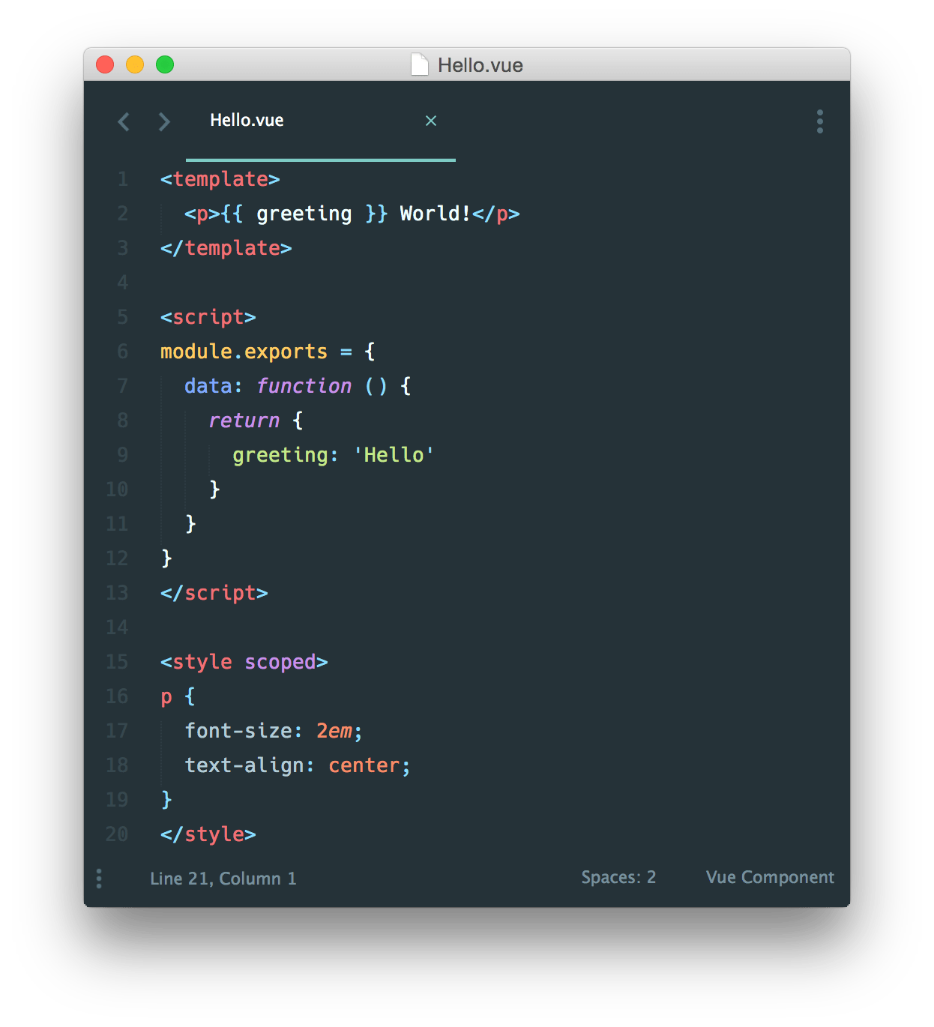

Slide 15
webpack configs
Putting it all together in an (sometimes) ugly config file

Slide 16
Some examples
Basic
https://github.com/webpack/webpack/blob/master/examples/two-explicit-vendor-chunks/webpack.config.js
Advanced
https://github.com/pangolinjs/core/tree/master/lib/config
Insane
https://github.com/vuejs/vue-cli/tree/dev/packages/%40vue/cli-service/lib/config

